Slide 1
MAC & HMAC

Slide 2
MAC (Message Authentication Code)

Slide 3
Message Authentication
Message Authentication is concerned with:
Protecting the integrity of the message (i.e., contain no modification, insertion, deletion or replay)
Validating identity of originator.
It is offered in the following areas;
Message encryption
Hash function
Message Authentication Code (MAC)
Notes:
File can be hacked by the hacker
Somoeone tries to send the message as an legititmate user
We need a mechanism to authenticate the message
Check whether the message is really sent by legitimate user or if the message is altered
Hash function- to verify the users

Slide 4
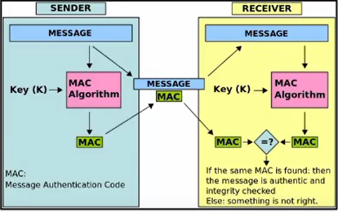
Message Authentication Code (MAC)
Message authentication ensures Integrity & source legality.
A MAC is an algorithm that requires the use of a secret key.
A MAC takes a variable length message & a secret key as Input and produces an authentication code.
A recipient is possession of the secret key can generate an authentication code to verify the Integrity of the message
MAC = MAC(K,M)
Finally from Source M+MAC → Transmitted to destination
M→ Tomorrow is an instructional day
K=53
MAC = MAC(K,M)
= MAC(53, Tomorrow is an instructional day)
= 12345
Tomorrow is an instructional day+12345 → Transmitted to destination

Slide 5
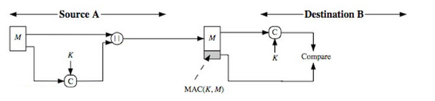
How message authentication code (MAC) works?

Slide 6
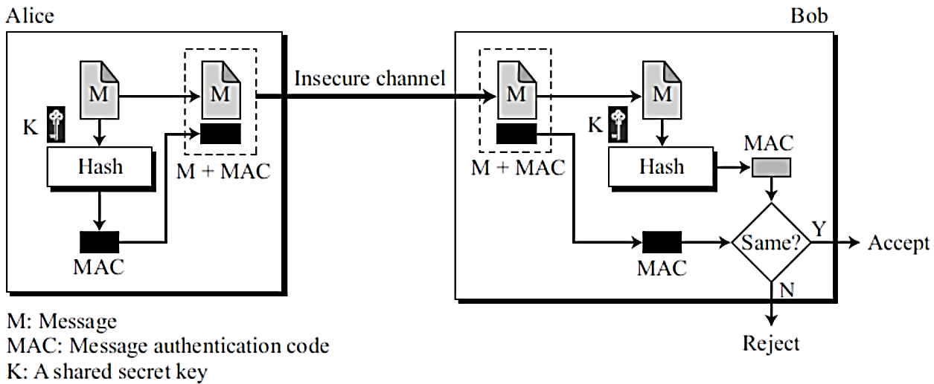
Message Authentication Code (MAC)
Tomorrow is an instructional day+12345

Slide 7
Message Authentication Code (MAC)
Tomorrow is an instructional day+12345
Tomorrow is holiday+12345
Hacker – altered the message

Slide 8
Message Authentication Code (MAC)
Tomorrow is an instructional day+12345
Tomorrow is holiday+12345
Hacker – altered the message
Tomorrow is holiday
77234
12345
No matching of hash code

Slide 9
STEPS:
The sender and receiver share a same secret key.
Produce a MAC with message and secret key as inputs.
The generated MAC is appended to the message and sent to the receiver.
At the receiving end, the receiver also generates the MAC with the same shared key.
Then compared the computed MAC with the received MAC generated by the sender.
If both the MACs are equal, then the message is valid and coming from the correct sender, otherwise, the message is invalid.
A message’s hash value would be different then it indicating to a receiver that it wasn’t from the original sender.

Slide 10
Use of MAC
The receiver is assured that the message has not been altered. If an attacker alters the message but does not alter the MAC, then the receiver’s calculation of the MAC will differ from the received MAC. Because the attacker is assumed not to know the secret key, the attacker cannot alter the MAC to correspond to the alterations in the message.
The receiver is assured that the message is from the trusted sender. Because no one else knows the secret key, no one else could prepare a message with a proper MAC.

Slide 11
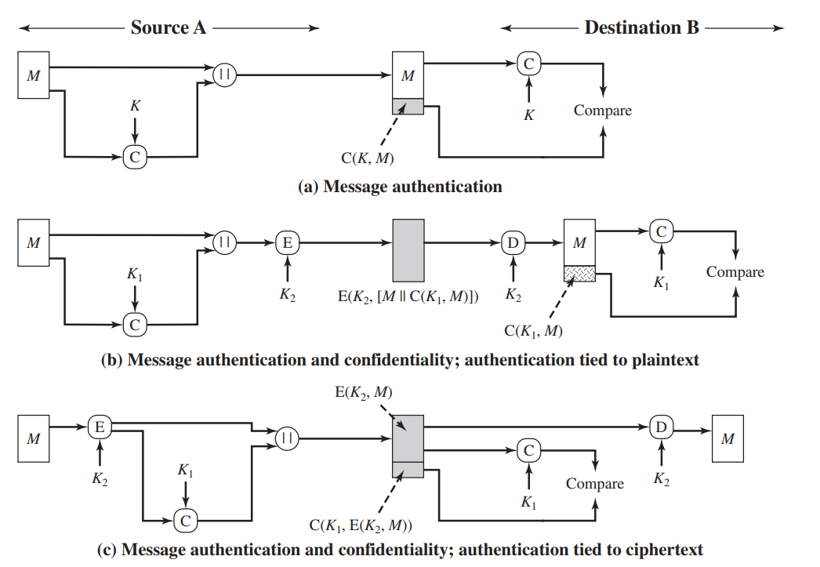
Basic use of MAC Functions
Notes:
Confidentiality aiming to protect sensitive data from unauthorized access,
Authentiation-verifying the identity of a user
--only legitimate users or entities gain access to protected resources.

Slide 12
MAC types
Hash-function based (HMAC)
Stream Cipher-based
Block Cipher-based

Slide 13
HMAC – Hash Based Message Authentication

Slide 14
HMAC
HMAC (short for "Keyed-Hash Message Authentication Code") is a cryptographic hash function that uses a secret key as input to the hash function along with the message being hashed.
The resulting hash value is unique to the message and the secret key, and can be used to verify the integrity and authenticity of the message.

Slide 15
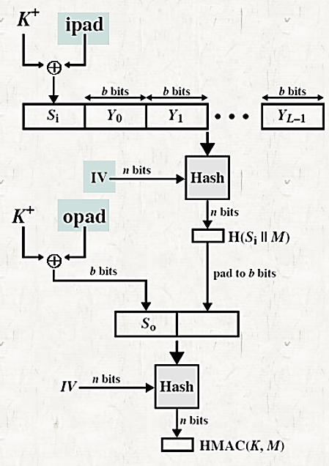
HMAC
IV = initial value input to hash function
M = message input to HMAC
Y – L number of 1024 bit blocks
K = secret key
= padded zeros to left to make it 1024 bits
ipad = 00110110 repeated b/8 times
opad = 01011100 repeated b/8 times
NOTE:
Assume hashing – SHA512. so each block is 1024 bit.
b=1024
b/8=128
So 128 times we need to repeat 00110110 to generate ipad
Ex: 00110110 00110110 00110110 00110110 00110110 00110110 …
ipad= 8*128=1024 bits
128 times we need to repeat 01011100 to generate opad
Ex: 01011100 01011100 01011100 01011100 01011100 01011100 …
1024 bits
1024 bits
1024 bits
1024 bits
Notes:
Si – expanded secret key
Secret key is responsible to validate the sender
B=1024
b/8=128

Slide 16
HMAC
IV = initial value input to hash function
M = message input to HMAC
Y – L number of 1024 bit blocks
K = secret key
= padded zeros to left to make it 1024 bits
ipad = 00110110 repeated b/8 times
opad = 01011100 repeated b/8 times
NOTE:
Assume hashing – SHA512. so each block is 1024 bit.
b=1024
b/8=128
So 128 times we need to repeat 00110110 to generate ipad
Ex: 00110110 00110110 00110110 00110110 00110110 00110110 …
ipad= 8*128=1024 bits
128 times we need to repeat 01011100 to generate ipad
Ex: 01011100 01011100 01011100 01011100 01011100 01011100 …
1024 bits
1024 bits
1024 bits
1024 bits
1024 bits
1024 bits

Slide 17
HMAC
Expanded Key S_{i} = K⁺ XOR ipad
1024 bit 1024 bit 1024 bit
IV = initial value input to hash function
M = message input to HMAC
Y – L number of 1024 bit blocks
K = secret key
= padded zeros to left to make it 1024 bits
ipad = 00110110 repeated b/8 times
opad = 01011100 repeated b/8 times
NOTE:
Assume hashing – SHA512. so each block is 1024 bit.
b=1024
b/8=128
So 128 times we need to repeat 00110110 to generate ipad
Ex: 00110110 00110110 00110110 00110110 00110110 00110110 …
ipad= 8*128=1024 bits
128 times we need to repeat 01011100 to generate ipad
Ex: 01011100 01011100 01011100 01011100 01011100 01011100 …
1024 bits
1024 bits
1024 bits
1024 bits
1024 bits
1024 bits

Slide 18
HMAC
Expanded Key S_{i} = K⁺ XOR ipad
1024 bit 1024 bit 1024 bit
IV = initial value input to hash function
M = message input to HMAC
Y – L number of 1024 bit blocks
K = secret key
= padded zeros to left to make it 1024 bits
ipad = 00110110 repeated b/8 times
opad = 01011100 repeated b/8 times
NOTE:
Assume hashing – SHA512. so each block is 1024 bit.
ipad:
b=1024
b/8=128
So 128 times we need to repeat 00110110 to generate ipad
Ex: 00110110 00110110 00110110 00110110 00110110 00110110 …
ipad= 8*128=1024 bits
opad:
128 times we need to repeat 01011100 to generate ipad
Ex: 01011100 01011100 01011100 01011100 01011100 01011100 …
1024 bits
1024 bits
1024 bits
1024 bits
1024 bits
1024 bits
1024 bits
SHA512

Slide 19
HMAC
Expanded Key S_{i} = K⁺ XOR ipad
1024 bit 1024 bit 1024 bit
IV = initial value input to hash function
M = message input to HMAC
Y – L number of 1024 bit blocks
K = secret key
= padded zeros to left to make it 1024 bits
ipad = 00110110 repeated b/8 times
opad = 01011100 repeated b/8 times
NOTE:
Assume hashing – SHA512. so each block is 1024 bit.
ipad:
b=1024
b/8=128
So 128 times we need to repeat 00110110 to generate ipad
Ex: 00110110 00110110 00110110 00110110 00110110 00110110 …
ipad= 8*128=1024 bits
opad:
128 times we need to repeat 01011100 to generate ipad
Ex: 01011100 01011100 01011100 01011100 01011100 01011100 …
1024 bits
1024 bits
1024 bits
1024 bits
1024 bits
1024 bits
512 bits
SHA512
1024 bits
1024 bits
512 bits
512 bits
1024 bits
1024 bits
1024 bits
1024 bits
512 bits
512 bits

Slide 20
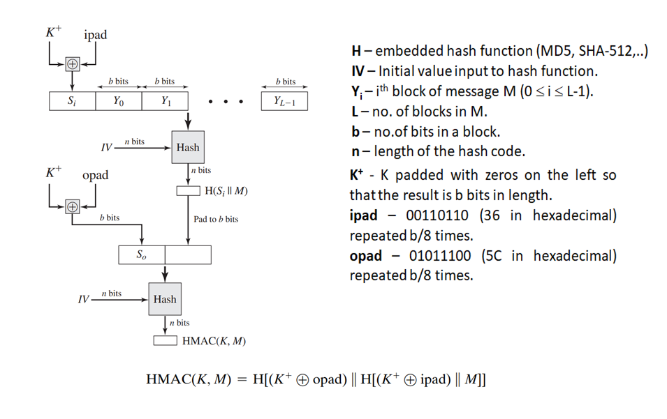
HMAC Structure

Slide 21
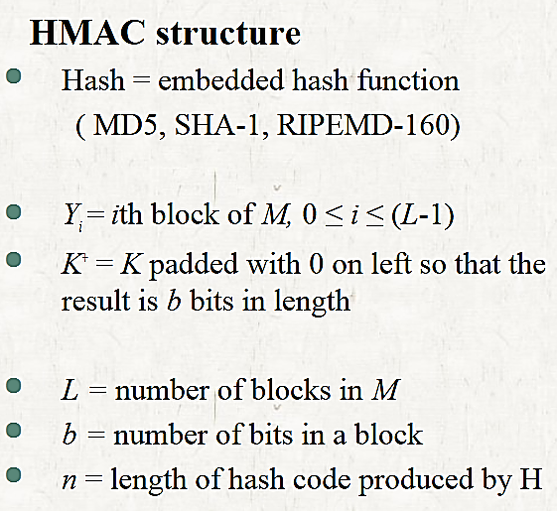
HMAC

Slide 22
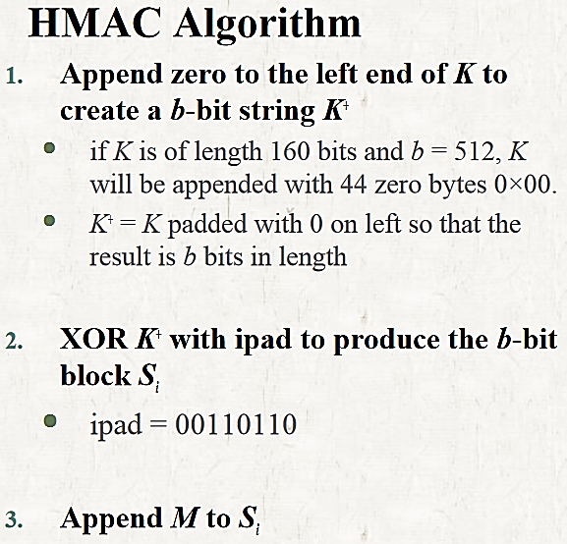
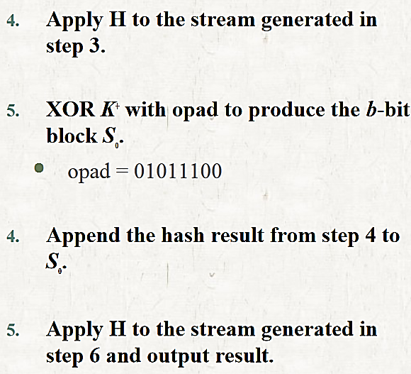
HMAC

Slide 23
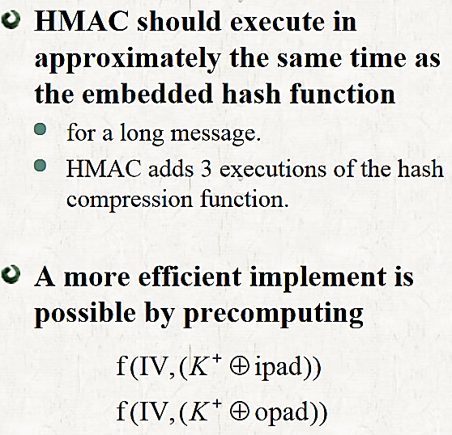
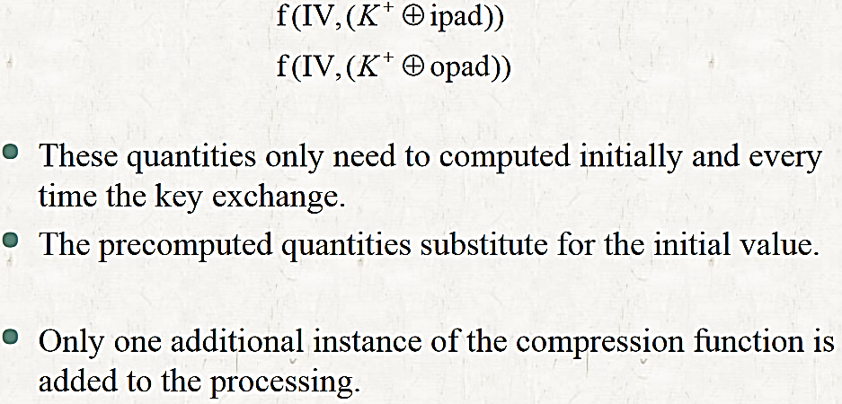
HMAC

Slide 24
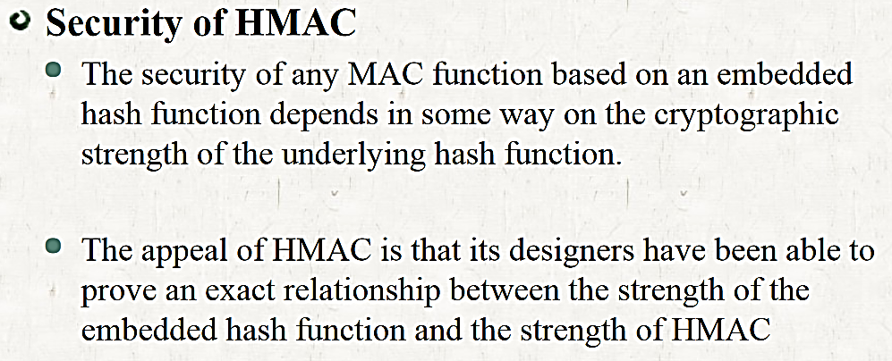
HMAC

Slide 25
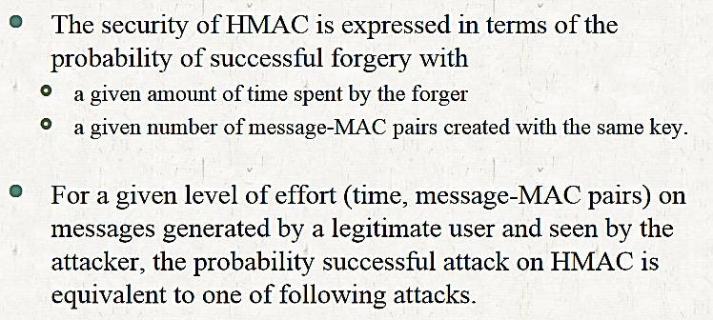
HMAC

Slide 26
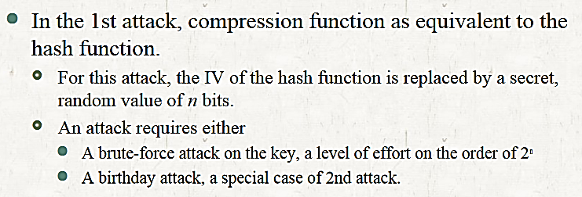
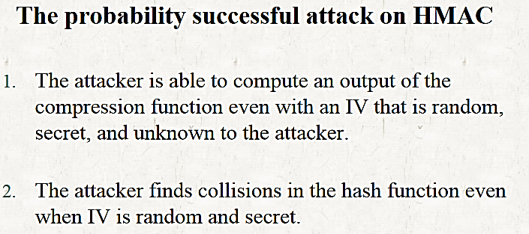
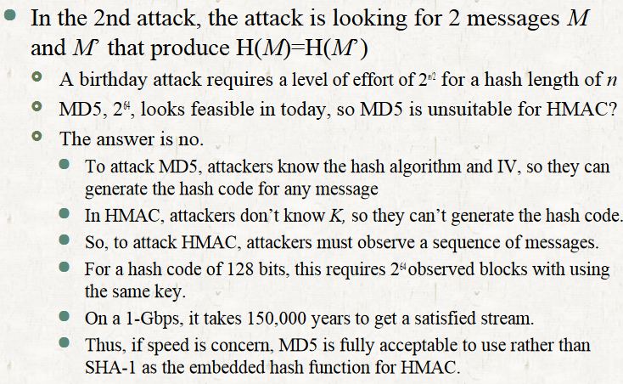
HMAC

Slide 27
HMAC vs Digital signature
HMAC is quite similar to Digital signature since both of them use a hash function and a shared key, but the difference between them is that MACs utilize symmetric keys (same key) whereas Digital Signatures use asymmetric keys (two different keys).

Slide 28
Example
Suppose in the HMAC algorithm, the Message M = “Hello” and the Key K = “Hi”. Find out the ‘S_{i}’ and ‘S_{o}’ based on the Hex Conversion of ASCII characters where the length of the hash code ‘n’ is 4 bits.

Slide 29
Example
Solution
Message M = “Hello”
M = 48 65 6C 6C 6F
01001000 01100101 01101100 01101100 01101111
b = 40 bits
K = “Hi”
K = 48 69
01001000 01101001
K = 16 bits
Given n = 4 bits
Now to produce Si, we have K⁺ XOR ipad
K⁺ = K padded with 0s on the left so that the result is b bits in length
ipad = 00110110 (36 in Hex) repeated b/8 times
K⁺: 00 00 00 48 69
ipad: 36 36 36 36 36
Hence, Si =
00 00 00 48 69 XOR
36 36 36 36 36
--------------------
36 36 36 7E 5F
--------------------
Notes:
b- no of bits in the block-8 * 5=40
L= length of hash code

Slide 30
Example
Similarly
opad = 01011100 (5C in Hex) repeated b/8 times
K+: 00 00 00 48 69
opad: 5C 5C 5C 5C 5C
Hence, So =
00 00 00 48 69 XOR
5C 5C 5C 5C 5C
---------------------
5C 5C 5C 14 35
---------------------

Slide 31
ASCII Character | Hexadecimal | ASCII Character | Hexadecimal
A | 41 | a | 61
B | 42 | b | 62
C | 43 | c | 63
D | 44 | d | 64
E | 45 | e | 65
F | 46 | f | 66
G | 47 | g | 67
H | 48 | h | 68
I | 49 | i | 69
J | 4A | j | 6A
K | 4B | k | 6B
L | 4C | l | 6C
M | 4D | m | 6D
N | 4E | n | 6E
O | 4F | o | 6F
P | 50 | p | 70
Q | 51 | q | 71
R | 52 | r | 72
S | 53 | s | 73
T | 54 | t | 74
U | 55 | u | 75
V | 56 | v | 76
W | 57 | w | 77
X | 58 | x | 78
Y | 59 | y | 79
Z | 5A | z | 7A

Slide 32
Birthday Attack

Slide 33
Birthday Attack
A birthday attack is a type of cryptographic attack that relies on the birthday paradox to find a collision in a hash function.
The birthday problem states that in a group of 23 people, there’s a 50% chance that at least two will have the same birthday.
This probability increases rapidly as the group size gets bigger. For instance, in a group of 50 people, the likelihood is already over 97%.
A birthday attack takes advantage of this statistical property by trying to find two different input messages that produce the same hash value. This is called a collision.
Notes:
Adventure
to create fake messages or forge digital signatures.

Slide 34
Birthday Attack
It is cryptographic attack that belongs to a class of brute force attacks
It is used against the cryptographic hash function
Assume Birthday of the student → Day is March 17
Probability that at least one student is born on that day is
1-(364/365)^{n}
Probability that at least one student has the same birthday as any other student
1 - 365!/((365 - n!) * (365^{n})) (substituting n = 30 here)

Slide 35
Birthday Attack
Probability that at least one student is born on that day is
1-(364/365)^{n}
For example, if the teacher fixes a particular date say March 13, then the probability that at least one student is born on that day is 1 – (364/365)³⁰ which is about 7.9%.

Slide 36
Digital Signature Susceptibility
Digital signatures are susceptible to a number of attacks that can compromise their security. Some of the main threats include −
Forgery − An attacker could create a fake signature and attach it to a message or document in an attempt to make it appear as if it was signed by someone else.
Tampering − An attacker could alter the content of a message or document after it has been signed, potentially changing the meaning of the message or document.
Repudiation − An attacker could claim that they did not sign a message or document, even if it is clear that they did.
Key compromise − If an attacker is able to obtain a private key that is used to create digital signatures, they could use it to create fake signatures or alter signed messages or documents.
To protect against these threats, it is important to use strong cryptographic techniques and to securely store and manage private keys used for digital signatures. It is also important to use trusted third parties, such as certificate authorities, to verify the identity of the parties involved in a digital signature.
Notes:
● Digital Signatures: If a birthday attack results in two different documents having the same hash, an attacker could forge a digital signature, leading to potentially fraudulent activities being perceived as legitimate. ● Password Storage Systems: A collision here could allow an attacker to gain access by finding a different password that produces the same hash as the original, bypassing security checks without needing the actual password. ● SSL/TLS Certificates: Secure Sockets Layer (SSL) and Transport Layer Security (TLS) certificates use hash functions for internet communication, and collisions in these hash functions could enable attackers to spoof these certificates, leading to potential man-in-the-middle attacks.

Slide 37
How to Prevent Birthday Attack?
How to Prevent Birthday Attack?
There are several ways to prevent or mitigate the risk of a birthday attack −
Use a hash function with a larger output size − The larger the output size, the less likely it is that two different input messages will produce the same output. Therefore, using a hash function with a large output size can make it much more difficult for an attacker to find a collision.
Use a different cryptographic technique − Instead of using a hash function, it is possible to use other cryptographic techniques that are not vulnerable to birthday attacks. For example, message authentication codes (MACs) or digital signatures can be used to provide similar functions as hash functions but without the risk of a collision.
Use a salt − A salt is a random value that is added to the input of a hash function before it is hashed. This can help to prevent precomputation attacks, in which an attacker precomputes a table of common inputs and their corresponding hash values. By adding a unique salt to each input, it becomes much more difficult for an attacker to precompute a table of hashes.
Use a keyed hash function − A keyed hash function is a type of hash function that uses a secret key in the hashing process. This makes it much more difficult for an attacker to find a collision, since they would need to know the key in order to generate a collision.
Use multiple hash functions − Instead of using a single hash function, it is possible to use multiple hash functions in parallel. This can make it much more difficult for an attacker to find a collision, since they would need to find collisions in all of the hash functions simultaneously.

